Slide 1

Sept, 2016
Python Beginners Primer I
Ayan Chakraborty

Slide 2
Contents (Basics Part I)
Overview
Application of Python
Know Your Environment
Programming Basics
Object Types
Making Decisions
Loops & Functions
Useful one liners

Slide 3
Contents (Basics Part II)
Object Management
File Handling
Exception Handling
Modules (sys,os,time,panda,urllib)
Json/xml Parsing
Real Time Scenario on Json
Useful one liners
Case Study

Slide 4
BASICS Part I

Slide 5

Overview
Python is a high-level, Interpreted, Interactive, Object-oriented scripting language which highly Readable.
Python's features include :
Interactive Mode
Extendable
History
Portable
C
Lips
GUI Programming
DB Interface
Python
Guido van Rossum

Slide 6
Overview (Cntd..)
Cross-compilers to other languages:
Jython compiles into Java byte code, which can then be executed by every Java virtual machine implementation. This also enables the use of Java class library functions from the Python program.
IronPython follows a similar approach in order to run Python programs on the .NET Common Language Runtime.
The RPython language can be compiled to C, Java bytecode, or Common Intermediate Language, and is used to build the PyPy interpreter of Python.
Pyjamas compiles Python to JavaScript.
Cython compiles Python to C and C++.
Pythran compiles Python to C++.
Somewhat dated Pyrex (latest release in 2010) and Shed Skin (latest release in 2013) compile to C and C++ respectively.
Google's Grumpy compiles Python to Go.

Slide 7

Application of Python
GUI-Based Applications
Gaming
Prototyping
Web Frameworks
and
Web Applications
Data Science
Language
Development
Operating Systems

Slide 8
Application of Python (Cntd..)
GUI-Based Applications
Python has simple syntax, modular architecture, rich text processing tools and the ability to work on multiple operating systems which make it a desirable choice for developing desktop-based applications. There are various GUI toolkits like wxPython, PyQt or PyGtk available which help developers create highly functional Graphical User Interface (GUI). The various applications developed using Python includes:
Image Processing and Graphic Design Applications : Python has been used to make 2D imaging software such as Inkscape, GIMP, Paint Shop Pro and Scribus. Further, 3D animation packages, like Blender, 3ds Max, Cinema 4D, Houdini, Lightwave and Maya, also use Python in variable proportions.
Scientific and Computational Applications : The higher speeds, productivity and availability of tools, such as Scientific Python and Numeric Python, have resulted in Python becoming an integral part of applications involved in computation and processing of scientific data. 3D modeling software, such as FreeCAD, and finite element method software, such as Abaqus, are coded in Python.

Slide 9
Application of Python (Cntd..)
Web Frameworks
and
Web Applications
Python has been used to create a variety of web-frameworks including CherryPy, Django, TurboGears, Bottle, Flask etc. These frameworks provide standard libraries and modules which simplify tasks related to content management, interaction with database and interfacing with different internet protocols such as HTTP, SMTP, XML-RPC, FTP and POP. Plone, a content management system; ERP5, an open source ERP which is used in aerospace, apparel and banking; Odoo – a consolidated suite of business applications; and Google App engine are a few of the popular web applications based on Python. Best of best www.youtube.com/
Operating Systems
Python is often an integral part of Linux distributions. For instance, Ubuntu’s Ubiquity Installer, and Fedora’s and Red Hat Enterprise Linux’s Anaconda Installer are written in Python. Gentoo Linux makes use of Python for Portage, its package management system.

Slide 10
Application of Python (Cntd..)
Language
Development
Python’s design and module architecture has influenced development of numerous languages. Boo language uses an object model, syntax and indentation, similar to Python. Further, syntax of languages like Apple’s Swift, CoffeeScript, Cobra, and OCaml all share similarity with Python.
Prototyping
Besides being quick and easy to learn, Python also has the open source advantage of being free with the support of a large community. This makes it the preferred choice for prototype development. Further, the agility, extensibility and scalability and ease of refactoring code associated with Python allow faster development from initial prototype.
Gaming
Python has various modules, libraries and platforms that support development of games. For example, PySoy is a 3D game engine supporting Python 3, and PyGame provides functionality and a library for game development. There have been numerous games built using Python including Civilization-IV, Disney’s Toontown Online, Vega Strike etc. Best of all Battle Field 2 and 2142

Slide 11
Application of Python (Cntd..)
XML
HTML
Json
Text
Parsing
Matrix
Excel
Data Structure
Graph plot
Data Analysis
Data Science
Logistic regression
Predictive Modeling
SVM
Regression
Data Mining
Anomaly Detection
K means clustering
Artificial Intelligence
AI Technique

Slide 12

Know Your Environment
Python installation confirmation can be done using below commands
$python # Unix/Linux
python% # Unix/Linux
C:>python # Windows/DOS
Note : If python application is not available then visit https://www.python.org/downloads to download latest python version.
Make sure python globally accessible by adding python PATH to the PATH ENVIRONMENTAL variable.
PATH="$PATH:/usr/local/bin/python3 and press enter”. # Unix/Linux
path %path%;C:\Python and press Enter. # Windows/DOS
Check python by using “Python -V” command.
Using an Editor is individual's choice but its recommended to use PyCharm.
PyCharm can be installed using https://www.jetbrains.com/pycharm/

Slide 13
Programming Basics
Interactive Mode Programming :
$ Python # invoking interpreter without passing a script file
Print “Welcome to the world of python !!”
Script Mode Programming :
$ Python <Script Name>.py # Invoking the interpreter with a script parameter begins execution of the script and continues until the script is finished.
Note : Python files should have extension .py
Lines and Indentation :
Blocks of code are denoted by line indentation, which is rigidly enforced.
Example :
if True:
print "True” # Indentation is being ensured using <tab>
else:
print "False"

Slide 14
Programming Basics (Cntd..)
Multi-Line Statements :
In case of multi line statement, need to use line continuation character (\) to denote that the line should continue.
Example :
X = A + \
B + \
C
Quotation in Python :
word = 'word'
sentence = "This is a sentence."
paragraph = """This is a paragraph. It is
made up of multiple lines and sentences."""

Slide 15
Programming Basics (Cntd..)
Comments in Python :
# Single line comment.
'''Multi
Line
Comment '''
User's input :
Raw_input() → Take the stdin as an input string by default. (implicit casting)
Name = raw_input(“What is ur name ? ”)
What is ur name ? Cognizant (stdin)
Stdout : Cognizant
Input() → Explicitly have to mention about the input Type.
Name = input(“What is ur name ? ”)
What is ur name ? “Cognizant” (stdin)
Stdout : Cognizant

Slide 16
Programming Basics (Cntd..)
Call for help ??
Python<enter>
>>> help(print)
Help on built-in function print in module builtins:
print(...)
print(value, ..., sep=' ', end='\n', file=sys.stdout, flush=False)
Prints the values to a stream, or to sys.stdout by default.
Optional keyword arguments:
file: a file-like object (stream); defaults to the current sys.stdout.
sep: string inserted between values, default a space.
end: string appended after the last value, default a newline.
flush: whether to forcibly flush the stream.

Slide 17
Programming Basics (Cntd..)
How to declare and use a variable
Let see an example. We will declare variable "a" and print it.
a=100
print a
Re-declare a Variable
a=100
print (a)
a=“XYZ”
print (a)
Concatenate Variables
Unlike Java, which concatenates number with string without declaring number as string, Python requires declaring the number as string otherwise it will show a TypeError
a=“xyz"
b = 99
print (a+b)
print (a+str(b))

Slide 18
Programming Basics (Cntd..)
Local & Global Variables
A=100
global a = 100
Delete a variable
del a

Slide 19
Programming Basics (Cntd..)
Operator | Description | Example | Code
[] | Slice- it gives the letter from the given index | a[1] will give "y" from the word Ayan as such ( 0=G, 1=u, 2=r and 3=u) | var1 = "Ayan" print (var1[1])
[ : ] | Range slice-it gives the characters from the given range | x [1:3] it will give "ya" from the word Ayan. Remember it will not consider 0 which is A, it will consider word after that is ya. | var1 = "Ayan" print (var1[1:3])
in | Membership-returns true if a letter exist in the given string | n is present in word Ayan and hence it will give 1 (True) | var1 = "Ayan" print ("n" in var1)
not in | Membership-returns true if a letter exist is not in the given string | l not present in word Guru and hence it will give 1 | var1 = "Ayan" print ("n" not in var1)
r/R | Raw string suppresses actual meaning of escape characters. | Print r'\n' prints \n and print R'/n' prints \n | print (r'\n') print ('\n')
% - Used for string format | %r - It insert the canonical string representation of the object (i.e., repr(o)) %s- It insert the presentation string representation of the object (i.e., str(o)) %d- it will format a number for display | The output of this code will be "guru 99". | name = 'Ayan' number = 99 print ('%s %d' % (name,number))
+ | It concatenates 2 strings | It concatenate strings and gives the result | name = 'Ayan' number = '99' print (name+number)
* | Repeat | It prints the character twice. | name = 'Ayan' number = '99' print (name * 2)

Slide 20
Programming Basics (Cntd..)
Operator | Description | Example
replace() | The method replace() returns a copy of the string in which the values of old string have been replaced with the new value. | name = 'Ayan Chak' print (name.replace('Chak','Chakraborty'))
upper & lower | In Python, you can even change the string to upper case or lower case. | name = 'Ayan Chak' print (name.upper()) print (name.lower())
capitalize() | Likewise, you can also do for other function as well like capitalize | name = 'ayan chak' print (name.capitalize())
join | The join function is a more flexible way for concatenating string. With join function, you can add any character into the string | name = 'ayan chak' print (".".join(name))
reversed | By using the reverse function, you can reverse the string. | name = 'ayan chak' print (''.join(reversed(name))) print (name[::-1])
Split | Split strings is another function that can be applied in Python | name = 'ayan chak' print (name.split(' ')[0]) print (name.split(' ')[1])

Slide 21
Programming Basics (Cntd..)
Operators | Type | Description | Example
"+,-,*,/,%,**" | Arithmetic | Arithmetic Operators perform various arithmetic calculations like addition, subtraction, multiplication, division, %modulus, exponent, etc. | x=2 y=4 print (x**y)
eval() | Arithmetic | The eval function lets a python program run python code within itself | eval('x + 1')
"==, != , <>, >,<=, etc" | Comparison | These operators compare the values on either side of the operand and determine the relation between them. It is also referred as relational operators | print('x > y is',x>y) print (x == y)
"(+=, - = , *=, /=" | Assignment | Python assignment operators are used for assigning the value of the right operand to the left operand | x=2 z=0 z +=x print (z)
AND OR NOT | Logical | Logical operators in Python are used for conditional statements are true or false. Logical operators in Python are AND, OR and NOT. For logical operators following condition are applied. •For AND operator – It returns TRUE if both the operands (right side and left side) are true •For OR operator- It returns FALSE if either of the operand (right side or left side) is true •For NOT operator- returns TRUE if operand is false | a = True b = False print('a and b is',a and b) print('a or b is',a or b) print('not a is',not a)
NA | precedence | The operator precedence determines which operators need to be evaluated first. To avoid ambiguity in values, precedence operators are necessary. Just like in normal multiplication method, multiplication has a higher precedence than addition. For example in 3+ 4*5, the answer is 23, to change the order of precedence we use a square bracket (3+4)*5, now the answer is 35. Precedence operator used in Python are ( **, * / %, + - , &) etc. | v = 4 w = 5 x = 8 y = 2 z = 0 z = (v+w) * x / y print (z)

Slide 22
Programming Basics (Cntd..)
Create power full one liner to interact from shell??
One line to use the python
python -c "x = 'Hi there!!'; print(x)"
Hi there!!
One liner to interact with shell
x=“Python”
v_out=`python -c "y = 'Welcome to '; print(y$x)“`
Welcome to Python

Slide 23
Programming Basics (Cntd..)
Reserved Words:
and | else | import
assert | except | in
break | exec | Is
class | finally | lambda
continue | for | not
def | from | or
del | global | pass
elif | if | print

Slide 24
Object Types
Python treats every variables as Object, there are two categorization of object immutable & mutable types.
In general, data types in Python can be distinguished based on types of object.
Only mutable objects support methods that change the object in place, such as reassignment of a sequence slice, which will work for lists, but raise an error for tuples and strings.
" NULL " pointer known from other programming languages is " None “
Categorization of object types are as follows :
Int
Float
List
Set
Frozen Set
Long
Mutable
Objects
Immutable
Objects
Tuple
Complex
Dict
Byte Array
Binary
Str

Slide 25
Object Types (Cntd..)
Immutable
Objects
>>> v_id = 10
>>> print (v_id)
10
Int
>>> v_id = 10.124
>>> print (v_id)
10.124
Float
>>> v_Name = “Pyhon”
>>> print (v_Name)
Pyhon
Str
Binary
>>> v_id = 10124121323213244455666666666676
>>> print (v_id)
10124121323213244455666666666676
>>> v_id = 3+10j
>>> print (v_id)
3+10j
Str
>>> v_ind = True
>>> print (v_Name)
True
Long
>>> v_Name = “Welcome to the world of python \n showing the use of escape character \t”
>>> print (v_Name)
Welcome to the world of python
showing the use of escape character

Slide 26
Object Types (Cntd..)
Immutable
Objects
>>> v_cities = frozenset(["Frankfurt", "Basel","Freiburg"])
>>> print v_cities
["Frankfurt", "Basel","Freiburg"]
>>> v_cities.add("Strasbourg")
Traceback (most recent call last):
File "<stdin>", line 1, in <module>
AttributeError: 'frozenset' object has no attribute 'add'
>>> v_tuple = ( 'abcd', 786 , 2.23, 'john', 70.2 )
>>> print v_tuple
( 'abcd', 786 , 2.23, 'john', 70.2 )
>>> print v_tuple [0]
Abcd
>>> print v_tuple[1:3]
(786, 2.23)
>>> print v_tuple[2:]
(2.23, 'john', 70.2)
>>> print v_tuple * 2
( 'abcd', 786 , 2.23, 'john', 70.2, 'abcd', 786 , 2.23, 'john', 70.2 )
>>> print v_tuple + v_tuple
??
Frozen Set
Tuple

Slide 27
Object Types (Cntd..)
Mutable
Objects
>>> v_cities = set([“Kolkata", “Pune",“Bangalore"])
>>> print (v_cities)
[“Kolkata", “Pune",“Bangalore"]
>>> v_cities.add("Chennai")
>>> print (v_cities)
[“Kolkata", “Pune",“Bangalore" , "Chennai"]
>>> v_bary=bytearray('abcdef')
>>> v_bary
bytearray(b'abcdef')
>>> type(v_bary)
<type 'bytearray'>
>>> print v_bary [3]
100
>>> v_bary= bytearray.fromhex(u'00 ff')
>>> print (v_bary)
bytearray(b'\x00\xff')
>>> v_bary [1]
255
Set
Byte Array

Slide 28
Object Types (Cntd..)
Mutable
Objects
Deleting from a List
Defining a List
>>> v_list = [101,202,'Python','Java',10.00021];
>>> print v_list[0]
101
>>> list[0] = 2001;
>>> print v_list[0]
2001
>>> del v_list[0];
>>>print v_list
202,'Python','Java',10.00021
Accessing Values in Lists
Basic List Operations
Updating Lists
Python Expression | Results | Description
Len(v_list) | 4 | Length
v_list+ [‘Im in’] | [202,'Python','Java',10.00021,'Im in'] | Concatenation
['Hi!'] * 4 | ['Hi!', 'Hi!', 'Hi!', 'Hi!'] | Repetition
101 in v_list | False | Membership
for x in v_list: print x | 202 Python Java 10.00021 | Iteration
List

Slide 29
Object Types (Cntd..)
Sl No | Function & Description
1 | list.append(obj)
 | Appends object obj to list
2 | list.count(obj)
 | Returns count of how many times obj occurs in list
3 | list.index(obj)
 | Returns the lowest index in list that obj appears
4 | list.insert(index, obj)
 | Inserts object obj into list at offset index
5 | list.pop( list[-1])
 | Removes and returns second object or obj from list
6 | list.remove(obj)
 | Removes object obj from list
7 | list.reverse()
 | Reverses objects of list in place
8 | list.sort([func])
 | Sorts objects of list, use compare func if given

Slide 30
Object Types (Cntd..)
Mutable
Objects
Defining a Dict
Deleting from a List
>>> v_dict = {'Emp_Id': 595195, 'Emp_Name': 'Ayan', 'Manager_id': 226617}
>>> print v_dict[‘Manager_Id’]
226617
>>> v_dict [‘Emp_Name’] = ‘Ayan Chakraborty’
>>> print v_dict [‘Emp_Name’]
Ayan Chakraborty
>>> del [‘Emp_Name
>>> print v_dict
'Emp_Id': 595195, 'Manager_id': 226617
>>> print v_dict.clear();
>>>del v_dict;
Accessing Values in Lists
Updating Lists
Dict

Slide 31
Object Types (Cntd..)
S.No. | Method & Description
1 | dict.clear()
 | Removes all elements of dictionary dict
2 | dict.copy()
 | Returns a shallow copy of dictionary dict
3 | dict.fromkeys()
 | Create a new dictionary with keys from seq and values set to value.
4 | dict.get(key, default=None)
 | For key key, returns value or default if key not in dictionary
5 | dict.items()
 | Returns a list of dict's (key, value) tuple pairs
6 | dict.keys()
 | Returns list of dictionary dict's keys
7 | dict.update(dict2)
 | Adds dictionary dict2's key-values pairs to dict
8 | dict.values()
 | Returns list of dictionary dict's values

Slide 32
Making Decisions
An if statement consists of a boolean expression followed by one or more statements.
v_var = 100
if v_var == 100:
print “Variable value is :” ,v_var
Variable value is : 100
An if statement can be followed by an optional else statement, which executes when the boolean expression is FALSE.
v_var = 100
if v_var == 200:
print “ Getting expected value!! ”
else:
print “Expecting 200 but getting ”, v_var
Expecting 200 but getting 100

Slide 33
Making Decisions (Cntd..)
One if or else if statement inside another if or else if statement(s).
v_var = 100
if v_var < 100:
print "Expression value is less than 100"
elif v_var > 100:
print "Expression value is greater than 100"
else:
print "Expression value is 100“
Expression value is 100

Slide 34
Loops & Functions
WHILE LOOP : Repeats a statement or group of statements while a given condition is TRUE. It tests the condition before executing the loop body.
v_seq =1
while (v_seq < 11):
Print "The sequence is : ",v_seq
v_seq + = 1
print "EOL!“
The sequence is : 1
The sequence is :2
The sequence is :3
The sequence is :4
The sequence is :5
The sequence is :6
The sequence is :7
The sequence is :8
The sequence is :9
The sequence is :10
EOL

Slide 35
Loops & Functions (Cntd..)
FOR LOOP : Executes a sequence of statements multiple times and abbreviates the code that manages the loop variable.
for v_seq in range(1,11):
Print "The sequence is : ",v_seq
print "EOL!“
The sequence is : 1
The sequence is :2
The sequence is :3
The sequence is :4
The sequence is :5
The sequence is :6
The sequence is :7
The sequence is :8
The sequence is :9
The sequence is :10
EOL

Slide 36
Loops & Functions (Cntd..)
BREAK STATEMENT : Terminates the loop statement and transfers execution to the statement immediately following the loop.
v_seq =1
while (1):
Print "The sequence is : ",v_seq
v_seq + = 1
if v_seq == 6:
break;
print "EOL!“
The sequence is :1
The sequence is :2
The sequence is :3
The sequence is :4
The sequence is :5
EOL

Slide 37
Loops & Functions (Cntd..)
CONTINUE STATEMENT : Terminates the loop statement and transfers execution to the statement immediately following the loop.
for v_seq in range(1,11):
if v_seq == 5:
continue
Print "The sequence is : ",v_seq
print "EOL!"
The sequence is :1
The sequence is :2
The sequence is :3
The sequence is :4
The sequence is :6
The sequence is :7
The sequence is :8
The sequence is :9
The sequence is :10
EOL

Slide 38
Loops & Functions (Cntd..)
PASS STATEMENT : The pass statement in Python is used when a statement is required syntactically but you do not want any command or code to execute.
v_seq =1
for v_seq in range(1,8):
if v_seq == 5:
pass
Print "The sequence is : ",v_seq
print "EOL!"
The sequence is :1
The sequence is :2
The sequence is :3
The sequence is :4
The sequence is :5
The sequence is :6
The sequence is :7
EOL

Slide 39
Loops & Functions (Cntd..)
FUNCTION : Function is nothing but a block of re-usable codes.
Function blocks begin with the keyword def followed by the function name and parentheses ( ( ) ).
def Display(p_owner_name):
print p_owner_name
return;
PASS BY REFERENCE PASS BY VALUE:
def programin_language(p_lang):
p_lang.append('c++');
lang_list=['Python'];
programin_language (lang_list)
print (lang_list);
[‘C++’,’Python’]
def programin_language(p_lang):
p_lang= 'C++';
lang_list=['Python'];
programin_language (lang_list[0])
print (lang_list);
[‘Python’]
VS

Slide 40
Loops & Functions (Cntd..)
ANONYMOUS FUNCTION : Anonymous Function is a function definition that is not bound to an identifier. Anonymous functions are often:
Arguments being passed to higher-order functions
or
Used for constructing the result of a higher-order function that needs to return a function.
Anonymous Function can be defined with the keyword "" lambda "“
lambda arguments: expression
sum = lambda p_arg_1, p_arg_2: p_arg_1 + p_arg_2;
print sum(4,5)
9
def sum (p_arg_1, p_arg_2):
return p_arg_1 + p_arg_2

Slide 41
Use of Lambda Function
Lambda functions are used along with built-in functions like filter(), map() and and reduce()
The lambda feature was added to Python due to the demand from Lisp programmers
The map() Function
def fahrenheit(T):
return ((float(9)/5)*T + 32)
def celsius(T):
return (float(5)/9)*(T-32)
temp = (36.5, 37, 37.5,39)
F = map(fahrenheit, temp)
C = map(celsius, F)
>>> Celsius = [39.2, 36.5, 37.3, 37.8]
>>> Fahrenheit = map(lambda x: (float(9)/5)*x + 32, Celsius)
>>> print (list(Fahrenheit))
[102.56, 97.700000000000003, 99.140000000000001, 100.03999999999999]
>>> C = map(lambda x: (float(5)/9)*(x-32), Fahrenheit)
>>> print (list(C))
[39.200000000000003, 36.5, 37.300000000000004, 37.799999999999997]

Slide 42
Use of Lambda Function (Cntd..)
map() can be applied to more than one list. The lists have to have the same length. map() will apply its lambda function to the elements of the argument lists, i.e. it first applies to the elements with the 0th index, then to the elements with the 1st index until the n-th index is reached:
>>> a = [1,2,3,4]
>>> b = [17,12,11,10]
>>> c = [-1,-4,5,9]
>>> list(map(lambda x,y:x+y, a,b))
[18, 14, 14, 14]
>>> list(map(lambda x,y,z:x+y+z, a,b,c))
[17, 10, 19, 23]
>>> list(map(lambda x,y,z:x+y-z, a,b,c))
[19, 18, 9, 5]

Slide 43
Use of Lambda Function (Cntd..)
Filtering
The function filter(function, list) offers an elegant way to filter out all the elements of a list, for which the function function returns True. The function filter(f,l) needs a function f as its first argument. f returns a Boolean value, i.e. either True or False. This function will be applied to every element of the list l. Only if f returns True will the element of the list be included in the result list.
>>> fib = [0,1,1,2,3,5,8,13,21,34,55]
>>> result = filter(lambda x: x % 2, fib)
>>> print (list(result))
[1, 1, 3, 5, 13, 21, 55]
>>> result = filter(lambda x: x % 2 == 0, fib)
>>> print (list(result))
[0, 2, 8, 34]

Slide 44
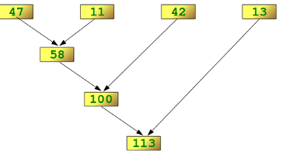
Use of Lambda Function (Cntd..)
reduce()
The function reduce(func, seq) continually applies the function func() to the sequence seq. It returns a single value. If seq = [ s1, s2, s3, ... , sn ], calling reduce(func, seq) works like this: At first the first two elements of seq will be applied to func, i.e. func(s1,s2) The list on which reduce() works looks now like this: [ func(s1, s2), s3, ... , sn ]
In the next step func will be applied on the previous result and the third element of the list, i.e. func(func(s1, s2),s3) The list looks like this now: [ func(func(s1, s2),s3), ... , sn ]
Continue like this until just one element is left and return this element as the result of reduce().
>>> reduce(lambda x,y: x+y, [47,11,42,13])
113
>>> f = lambda a,b: a if (a > b) else b
>>> reduce(f, [47,11,42,102,13])
102

Slide 45
Useful one liners
Print file extension:
print '~/python/one-liners.py'.split('.')[-1]
Reverse a line:
python -c "import sys; print '\n'.join(reversed(sys.stdin.read().split('\n')))“
Factorial:
print reduce(lambda x,y:x*y,range(1,n+1))
Max calculation:
max_xy = lambda x,y: x if x > y else y
print(max_xy(5,2))
List all python modules
python -c "help('modules')"

Slide 46
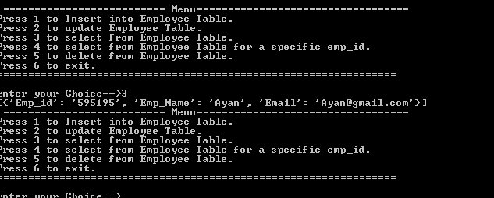
Case study
Create a NOSQL Employee structure (Emp_id,Emp_Name,Email) which allow insert , update,select and delete. Use menu driven approach.

Slide 47
Python Reference
https://www.python.org/doc/
Learning Python, 5th Edition - O'Reilly

Slide 48
BASICS Part II

Slide 49
Object Management
CLASS
Class is a blueprint of user defined prototype. It simply describes how to make more complicated data structures that contain arbitrary content. Defining a class does not allocate any space.
class CARD:
owner_name = "Ayan Chakraborty"
def card_name(self,p_card_name):
return (p_card_name)
def card_pin (self,p_pin):
return '*'*int(len(str(p_pin)))
obj = CARD()
print (obj.owner_name)
print (obj.card_name('Visa'))
print (obj.card_pin('password'))
Ayan Chakraborty
Visa
********

Slide 50
Object Management (Cntd..)
CONSTRUCTOR
Constructor in a class is a special type of subroutine called to create an object.
The constructor is always written as a function called __init__(). It must always take as its first argument a reference to the instance being constructed. This is typically called self. The rest of the arguments are up to the programmer.
class CARD:
def __init__(self,p_owner_name):
self.owner_name = p_owner_name
def card_name(self,p_card_name):
return (p_card_name)
def card_pin (self,p_pin):
return '*'*int(len(str(p_pin)))
obj = CARD('Ayan Chakraborty')
print (obj.owner_name)
print (obj.card_name('Visa'))
print (obj.card_pin('password'))
Ayan Chakraborty
Visa
********

Slide 51
Object Management (Cntd..)
OBJECT SCOPE
Class objects : Class variable is a variable defined in a class of which a single copy exists.
Global objects : Global variable is a variable with global scope, meaning that it is visible (hence accessible) throughout the program, unless shadowed.
Built-in objects refers to all the identifiers built into Python—those like range and min that can be used without having to import anything, and are (almost) always available
class CARD:
v_num = 100 # Class object
def __init__(self,p_owner_name):
self.owner_name = p_owner_name # Public object
if __name__ == "__main__": # Built-in object
obj = CARD('Ayan Chakraborty')
print (obj.v_num)
print (obj.owner_name)
100
Ayan Chakraborty

Slide 52
Object Management (Cntd..)
OBJECT SCOPE
class CARD:
v_num = 100
def __init__(self,p_owner_name):
self.__owner_name = p_owner_name # Private object
def display_fun(self):
print self.__owner_name
if __name__ == "__main__":
obj = CARD('Ayan Chakraborty')
obj.display_fun()
print (obj.v_num)
class CARD:
v_num = 100
def __init__(self,p_owner_name):
self.__owner_name = p_owner_name # Private variable
def display_fun(self):
self.__owner_name = 'Its fun'
if __name__ == "__main__":
obj = CARD('Ayan Chakraborty')
print obj.__owner_name
print (obj.v_num)
100
Ayan Chakraborty
Traceback (most recent call last):
File "prog.py", line 14, in <module>
AttributeError: CARD instance has no attribute '__owner_name'

Slide 53

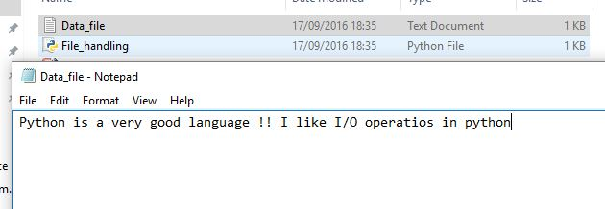

File Handling
Python provides basic functions and methods necessary to manipulate files by default. We can do most of the file manipulation using a file object.
v_file = open('Data_file.txt',"w")
v_file.writel("Python is a very good language !!")
v_file.write(" I like I/O operatios in python")
v_file.close()
with open('Data_file.txt',"r")as v_file:
for line in v_file:
print (line)

Slide 54
File Handling (Cntd..)
Different modes to open a file :
Modes | Description
r | Opens a file for reading only. The file pointer is placed at the beginning of the file. This is the default mode.
rb | Opens a file for reading only in binary format. The file pointer is placed at the beginning of the file. This is the default mode.
r+ | Opens a file for both reading and writing. The file pointer placed at the beginning of the file.
rb+ | Opens a file for both reading and writing in binary format. The file pointer placed at the beginning of the file.
w | Opens a file for writing only. Overwrites the file if the file exists. If the file does not exist, creates a new file for writing.
wb | Opens a file for writing only in binary format. Overwrites the file if the file exists. If the file does not exist, creates a new file for writing.
w+ | Opens a file for both writing and reading. Overwrites the existing file if the file exists. If the file does not exist, creates a new file for reading and writing.

Slide 55
File Handling (Cntd..)
Different modes to open a file :
Modes | Description
a | Opens a file for appending. The file pointer is at the end of the file if the file exists. That is, the file is in the append mode. If the file does not exist, it creates a new file for writing.
ab | Opens a file for appending in binary format. The file pointer is at the end of the file if the file exists. That is, the file is in the append mode. If the file does not exist, it creates a new file for writing.
a+ | Opens a file for both appending and reading. The file pointer is at the end of the file if the file exists. The file opens in the append mode. If the file does not exist, it creates a new file for reading and writing.
ab+ | Opens a file for both appending and reading in binary format. The file pointer is at the end of the file if the file exists. The file opens in the append mode. If the file does not exist, it creates a new file for reading and writing.

Slide 56

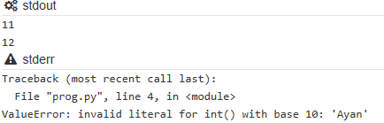
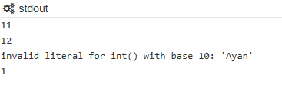
Exception Handling
An exception is an event, which occurs during the execution of a program that disrupts the normal flow of the program's instructions.
v_list = [11,12,'Ayan',True]
for i in range(0,len(v_list)):
print int(v_list[i])
v_list = [11,12,'Ayan',True]
for i in range(0,len(v_list)):
try:
print (int(v_list[i]))
except Exception as e:
print(e)

Slide 57
Exception Handling (Cntd..)
An exception is an event, which occurs during the execution of a program that disrupts the normal flow of the program's instructions.
fh = open("testfile.txt", "w")
for i in range(0,len(v_list)):
try:
fh.write((int(v_list[i])))
except Exception as e:
print(e)
finally:
fh.close()
print ("File Close !!")

Slide 58
ADVANCED

Slide 59



MODULES
Any Python file is a module. Basically modularization is a technique via which one can decoupled his codes and at the same time integrate all the codes into same platform.
import <module1>,<module2> ......<moduleN>
import os
print (os.getcwd())
import os,sys
print (os.getcwd(),sys.version)

Slide 60

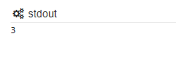
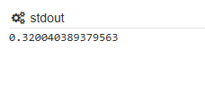
MODULES (Cntd..)
" from import " helps to import the specific module mentioned in " from " section, which basically avoids to import all the code snippet.
from os import system
print (system('ls'))
Built-in module MATH , typically used to access mathematics functions
import math
x =2.623
print (math.ceil(x))
math.pi : The mathematical constant π = 3.141592..., to available precision.
math.e : The mathematical constant e = 2.718281..., to available precision.
import math
x =60
print (math.tan(x))

Slide 61
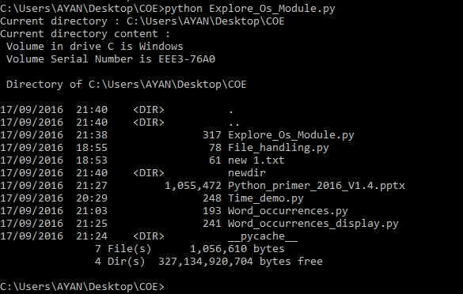
MODULES (Cntd..)
“OS” Module :
import os
os.rename( "Data_file.txt", "Data.txt" ) # Rename file.
os.remove("Data.txt") # Remove a file.
os.mkdir("newdir") # Create a directory.
print ("Current directory :",os.getcwd()) # Get current directory.
print ("Current directory content :")
os.system('dir') # Execute system command.

Slide 62
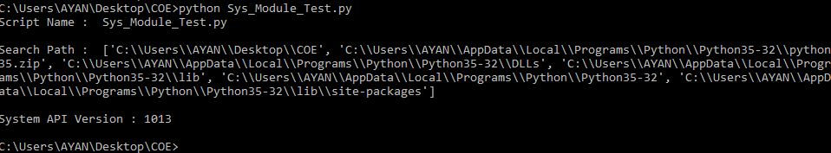
MODULES (Cntd..)
“Sys” Module :
import sys
print ( "Script Name : ",sys.argv[0] ) # Get parameter values from command prompt.
print ("\nSearch Path : ",sys.path) # Display search path
print ("\nSystem API Version :",sys.api_version) # Display API version of system
sys.exit(0) # Exit code.

Slide 63

MODULES (Cntd..)
“Time” Module :
import time
print (time.strftime('%Y-%m-%d'))
time.sleep(0.5) # in sec
print (time.strftime("%Y-%m-%d %H:%M:%S"))
print (time.clock()) # it returns a floating point number representing how many seconds have elapsed since your program started running

Slide 64
PARSING AND AUTOMATION MODULE
JSON
XML
Excel automation
Parsed XML documents are represented in memory by ElementTree and Element objects connected into a tree structure based on the way the nodes in the XML document are nested.
Python supports Excel automation , package xlwt (write in excel) and xlrd (read in excel)
The json module provides an API similar to pickle for converting in-memory Python objects to a serialized representation known as JavaScript Object Notation (JSON). Unlike pickle, JSON has the benefit of having implementations in many languages (especially JavaScript), making it suitable for inter-application communication. JSON is probably most widely used for communicating between the web server and client in an AJAX application, but is not limited to that problem domain.
Import json and use json.dumps,json.loads
fromxml.etree import ElementTree
xml.dom: the DOM API definition
xml.sax: SAX2 base classes and convenience functions
Import xlwt
wb=xlwt.Workbook()ws=wb.add_sheet('A Test Sheet')

Slide 65
BASIC LIBRARIES FOR DATA SCIENCE
NumPy
SciPy
Pandas
SciPy builds on NumPy by adding a collection of algorithms and high-level commands for manipulating and visualizing data. This package includes functions for computing integrals numerically, solving differential equations, optimization, and more.
Pandas adds data structures and tools that are designed for practical data analysis in finance, statistics, social sciences, and engineering. Pandas works well with incomplete, messy, and unlabeled data (i.e., the kind of data you’re likely to encounter in the real world), and provides tools for shaping, merging, reshaping, and slicing datasets.
NumPy is the foundational library for scientific computing in Python, and many of the libraries on this list use NumPy arrays as their basic inputs and outputs. In short, NumPy introduces objects for multidimensional arrays and matrices, as well as routines that allow developers to perform advanced mathematical and statistical functions on those arrays with as little code as possible.

Slide 66
BASIC LIBRARIES FOR DATA SCIENCE (Cntd..)
IPython
matplotlib
Plotly
matplotlib is the standard Python library for creating 2D plots and graphs. It’s pretty low-level, meaning it requires more commands to generate nice-looking graphs and figures than with some more advanced libraries. However, the flip side of that is flexibility. With enough commands, you can make just about any kind of graph you want with matplotlib.
Plotly is a web-based toolbox for building visualizations, exposing APIs to some programming languages (Python among them). There is a number of robust, out-of-box graphics on the plot.ly website. In order to use Plotly, you will need to set up your API key. The graphics will be processed server side and will be posted on the internet, but there is a way to avoid it
IPython extends the functionality of Python’s interactive interpreter with a souped-up interactive shell that adds introspection, rich media, shell syntax, tab completion, and command history retrieval. It also acts as an embeddable interpreter for your programs that can be really useful for debugging. If you’ve ever used Mathematica or MATLAB, you should feel comfortable with IPython.

Slide 67
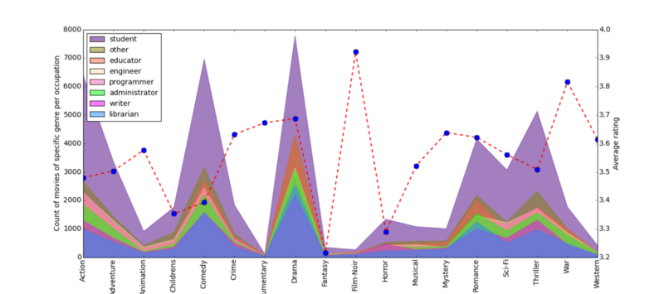
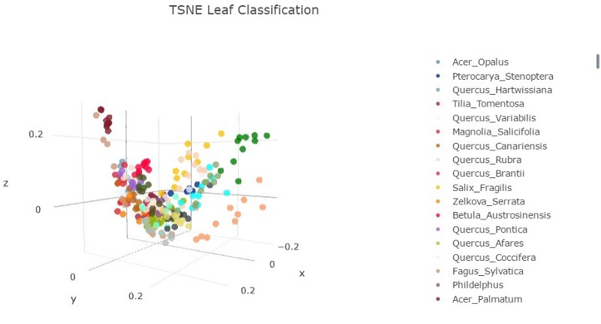
BASIC LIBRARIES FOR DATA SCIENCE (Cntd..)
Matplotlib
Plotly

Slide 68
LIBRARIES FOR MACHINE LEARNING
scikit-learn
Theano
TensorFlow
Theano uses NumPy-like syntax to optimize and evaluate mathematical expressions. What sets Theano apart is that it takes advantage of the computer’s GPU in order to make data-intensive calculations up to 100x faster than the CPU alone. Theano’s speed makes it especially valuable for deep learning and other computationally complex tasks.
TensorFlow is another high-profile entrant into machine learning, developed by Google as an open-source successor to DistBelief, their previous framework for training neural networks. TensorFlow uses a system of multi-layered nodes that allow you to quickly set up, train, and deploy artificial neural networks with large datasets. It’s what allows Google to identify objects in photos or understand spoken words in its voice-recognition app.
scikit-learn builds on NumPy and SciPy by adding a set of algorithms for common machine learning and data mining tasks, including clustering, regression, and classification. As a library, scikit-learn has a lot going for it. Its tools are well-documented and its contributors include many machine learning experts. What’s more, it’s a very curated library, meaning developers won’t have to choose between different versions of the same algorithm. Its power and ease of use make it popular with a lot of data-heavy startups, including Evernote, OKCupid, Spotify, and Birchbox.
http://scikit-learn.org/stable/
Decision Trees

Slide 69
LIBRARIES FOR PLOTTING AND VISUALIZATIONS
Seaborn
Bokeh
Basemap
Bokeh makes interactive, zoomable plots in modern web browsers using JavaScript widgets. Another nice feature of Bokeh is that it comes with three levels of interface, from high-level abstractions that allow you to quickly generate complex plots, to a low-level view that offers maximum flexibility to app developers.
Basemap adds support for simple maps to matplotlib by taking matplotlib’s coordinates and applying them to more than 25 different projections. The library Folium further builds on Basemap and allows for the creation of interactive web maps, similar to the JavaScript widgets created by Bokeh.
Seaborn is a popular visualization library that builds on matplotlib’s foundation. The first thing you’ll notice about Seaborn is that its default styles are much more sophisticated than matplotlib’s. Beyond that, Seaborn is a higher-level library, meaning it’s easier to generate certain kinds of plots, including heat maps, time series, and violin plots.

Slide 70
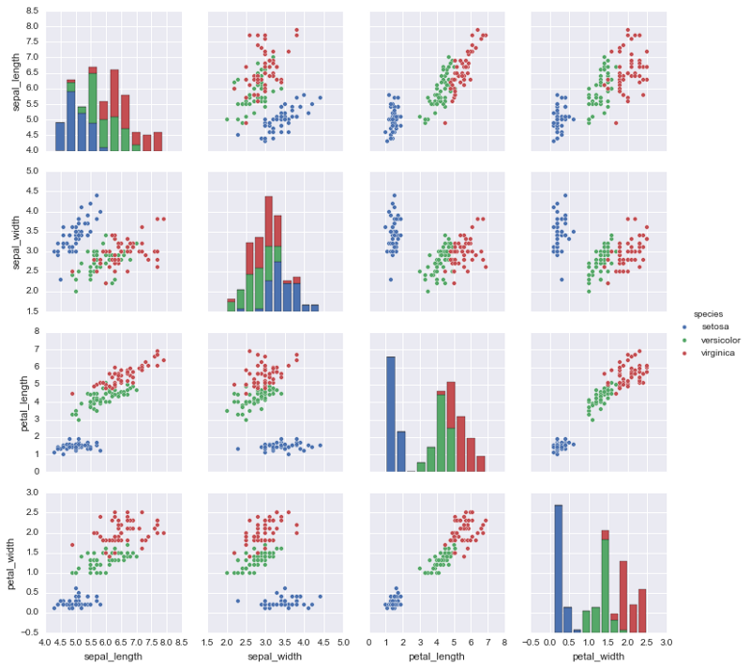
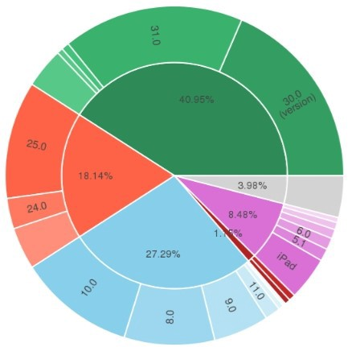
LIBRARIES FOR PLOTTING AND VISUALIZATIONS (Cntd..)
Seaborn
Bokeh

Slide 71
MODULES (Cntd..)
“pandas” data analysis / manipulation module for Python :
Pandas is a Python package providing fast, flexible, and expressive data structures designed to make working with "relational" or "labeled" data both easy and intuitive. It aims to be the fundamental high-level building block for doing practical, real world data analysis in Python. Additionally, it has the broader goal of becoming the most powerful and flexible open source data analysis / manipulation tool available in any language. It is already well on its way toward this goal.

Slide 72
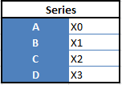
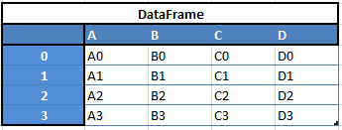
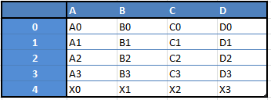
MODULES (Cntd..)
“Data Frames”, two-dimensional
“Series” — one-dimensional
For example, when you want to receive a new Dataframe from these two types of structures, as a result you will receive such DF by appending a single row to a DataFrame by passing a Series:

Slide 73
MODULES (Cntd..)
Easy handling of missing data (represented as NaN) in floating point as well as non-floating point data
Size mutability: columns can be inserted and deleted from DataFrame and higher dimensional objects
Automatic and explicit data alignment: objects can be explicitly aligned to a set of labels, or the user can simply ignore the labels and let Series, DataFrame, etc. automatically align the data for you in computations
Powerful, flexible group by functionality to perform split-apply-combine operations on data sets, for both aggregating and transforming data
Make it easy to convert ragged, differently-indexed data in other Python and NumPy data structures into DataFrame objects
Intelligent label-based slicing, fancy indexing, and sub setting of large data sets
Intuitive merging and joining data sets
Flexible reshaping and pivoting of data sets
Hierarchical labeling of axes (possible to have multiple labels per tick)
Robust IO tools for loading data from flat files (CSV and delimited), Excel files, databases, and saving/loading data from the ultrafast HDF5 format
Time series-specific functionality: date range generation and frequency conversion, moving window statistics, moving window linear regressions, date shifting and lagging, etc.

Slide 74
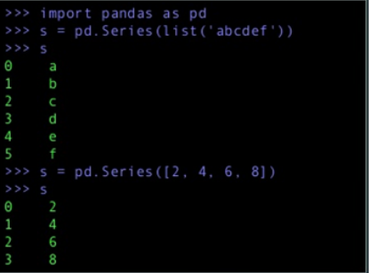
pandas - Data Structures: Series
One-dimensional array like object containing data and labels (or index)
Lots of ways to build a Series
import pandas as pd
s=pd.Series(list('abcdef') )
s

Slide 75
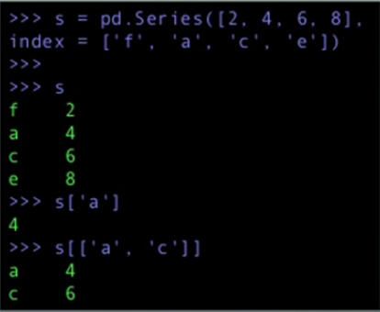
Series - Working with the index
● A series index can be specified
● Single values can be selected by index
● Multiple values can be selected with multiple indexes
s=pd.Series([2,4,6,8] ,index =['f',’a’,’c’,’e’])
s
s[‘a’]
s[[‘a’,’c’]]

Slide 76
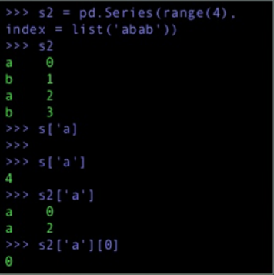
Series - Working with the index
● Think of a Series as a fixed-length, order dict
● However, unlike dict, index items don't have to be unique
s2=pd.Series(range(4),index =list('abab'))
s2
s[‘a’]
s2[‘a’]

Slide 77
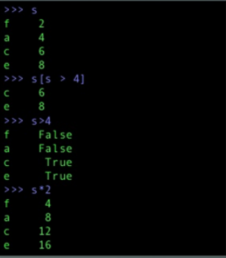
Series - Operations
● Filtering ● NumPy-type operations on data
s
s[s>4]
s>4
s*2

Slide 78
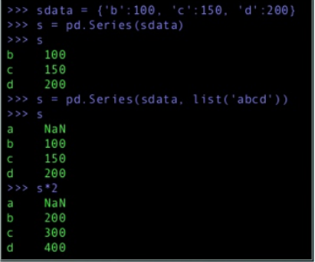
Series - Incomplete data
● pandas can accomodate incomplete data
sdata = {'b':100,'c':150,'d':200}
s=pd.Series(sdata)
s
s=pd.Series(sdata,list('abcd'))
s
s*2

Slide 79
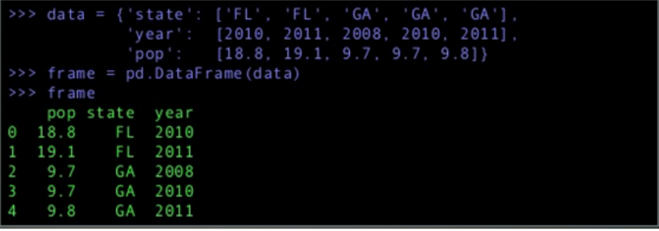
Data Structures: DataFrame
● Spreadsheet-like data structure containing an order collection of columns
● Has both a row and column index
● Consider as dict of Series (with shared index)
Data={'state':['FL','FL','GA','GA','GA'],'year':[2010,2011,2008,2010,2011],'pop':[18.8,19.1,9.7,9.7,9.8]}
frame =pd.DataFrame(data)
frame

Slide 80
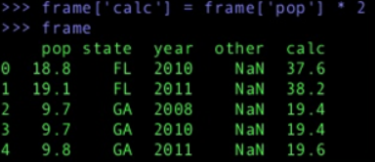
Data Structures: DataFrame
● New Columns can be added (by computation or direct assignment)
frame['calc']=frame['pop']*2
frame

Slide 81
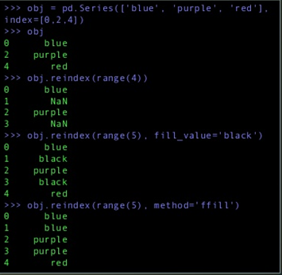
DataFrame - Reindexing
● Creation of new object with the data conformed to a new index
obj=pd.Series(['blue','purple','red'],index=[0,2,4])
obj
obj.reindex(range(4))
obj.reindex(range(5),fill_value='black')
obj.reindex(range(5),method='ffill')

Slide 82
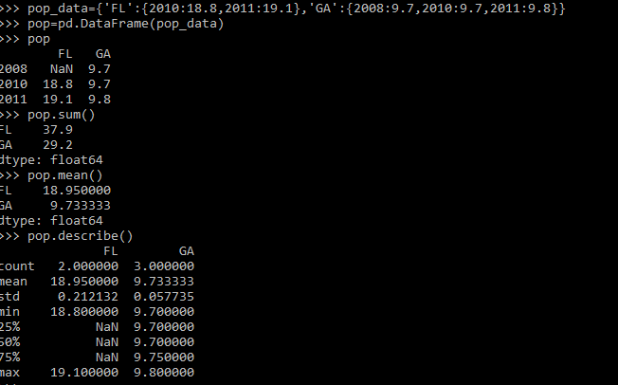
DataFrame - Reindexing
● Creation with dict of dicts
pop_data={'FL':{2010:18.8,2011:19.1},'GA':{2008:9.7,2010:9.7,2011:9.8}}
pop=pd.DataFrame(pop_data)
pop
pop.sum()
pop.mean()
pop.describe()

Slide 83
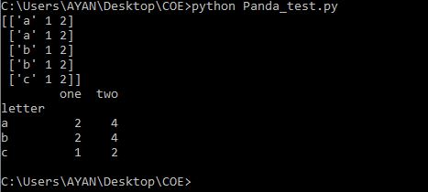
MODULES (Cntd..)
ExportCSV
v_text= {'one':[1,1,1,1,1],
'two':[2,2,2,2,2],
'letter':['a','a','b','b','c']}
v_text.to_csv('TGT_csv.txt', sep=',')
ImportCSV
import pandas as pd
# Our small data set
v_text = {'one':[1,1,1,1,1],
'two':[2,2,2,2,2],
'letter':['a','a','b','b','c']}
# Create dataframe
df = pd.DataFrame(v_text)
print (pd)
one = df.groupby('letter')
one.sum()
Location = r'C:\Users\AYAN\Desktop\COE\Source_csv.txt>'
df = pd.read_csv(Location)
Groupby
Group by O/P

Slide 84

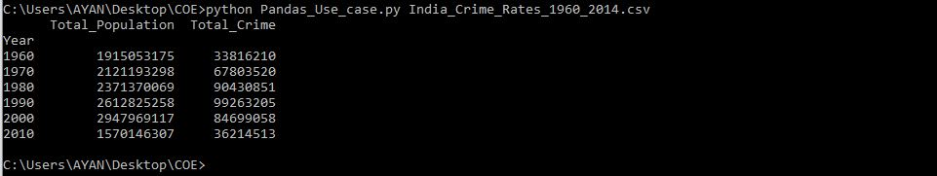
Use Case
Problem Statement :
Import a csv file as a data frame.
Add an extra column in dataframe (i.c. Delta = Population - Total Crime)
Group the year by decades and sum the values.
Delete the redundant year value.
Display as well as write the aggregated value into a csv file.

Slide 85
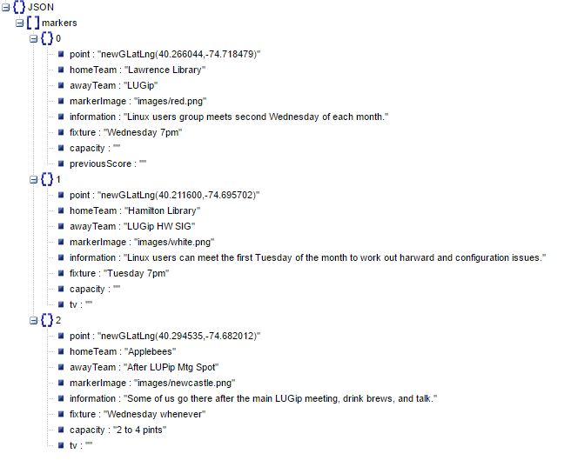

xml & json Parsing
JSON (JavaScript Object Notation) is a lightweight data-interchange format. It is easy for humans to read and write. It is basically a Key :: Value paired object.

Slide 86
xml & json Parsing (Cntd..)
Json module load
import json,sys
in_json_file = sys.argv[1]
with open(in_json_file) as json_data:
try:
json_obj = json.load(json_data)
print (type(json_obj))
except Exception as e:
print ("Error while loading source JSON file, Error msg: "+str(e)+"\n")

Slide 87

xml & json Parsing (Cntd..)
Json module dumps
import json
Emp_str = { "Emp_ID" : 101,"Name": "Tom", "age": 10 ,"Sal" : 500}
in_json_file = "Employee_Database.json"
with open(in_json_file,'w') as json_data:
try:
json_obj = json.dumps(Emp_str)
print (type(json_obj))
json_data.write(json_obj)
except Exception as e:
print ("Error while loading source JSON file, Error msg: "+str(e)+"\n")

Slide 88
Use Case (Cntd..)
Problem Statement :
Create a generic json parser for only one dimension json file.

Slide 89
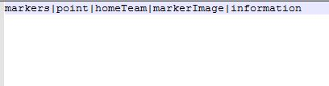
Use Case (Cntd..)
Config File
Python Generic_onedimension_parser.py Source_json_file.json Google_map.conf Lets_see.txt "|"
Source
Config
Source Code
O/P

Slide 90

AWS SDK for Python
Boto is the Amazon Web Services (AWS) SDK for Python, which allows Python developers to write software that makes use of Amazon services like S3 and EC2.
Boto 3 is a ground-up rewrite of Boto. It uses a data-driven approach to generate classes at runtime from JSON description files that are shared between SDKs in various languages. This includes descriptions for a high level, object oriented interface similar to those available in previous versions of Boto. Because Boto 3 is generated from these shared JSON files, we get fast updates to the latest services and features and a consistent API across services. Community contributions to JSON description files in other SDKs also benefit Boto 3, just as contributions to Boto 3 benefit the other SDKs

Slide 91
AWS SDK for Python
Configuring Credentials
Non-credentials
configuration includes items such as which region to use or which addressing style to use for Amazon S3
Credentials
Credentials include items such as aws_access_key_id, aws_secret_access_key, and aws_session_token
The distinction between credentials and non-credentials configuration is important because the lookup process is slightly different. Boto3 will look in several additional locations when searching for credentials that do not apply when searching for non-credential configuration.

Slide 92
AWS SDK for Python
Configuring With Credentials
The mechanism in which boto3 looks for credentials is to search through a list of possible locations and stop as soon as it finds credentials. The order in which Boto3 searches for credentials is:
Passing credentials as parameters in the boto.client() method
Passing credentials as parameters when creating a Session object
Environment variables
Shared credential file (~/.aws/credentials)
AWS config file (~/.aws/config)
Assume Role provider
Boto2 config file (/etc/boto.cfg and ~/.boto)
Instance metadata service on an Amazon EC2 instance that has an IAM role configured.
Reference : http://boto3.readthedocs.io/en/latest/guide/s3.html

Slide 93
Thank you

